Slide 1
GitHub Business Analytics
Nicolás Velásquez
Pontificia Universidad Javeriana

Slide 2

Intro to Git(Hub)
Motivation
Source: Phdeconomics

Slide 3
Intro to Git(Hub)
Motivation
Git:
Git is a distributed version control system
It is Optimized for the things that economists and data analyst/scientists spend a lot of time working on (e.g. code).
GitHub
It’s important to realize that Git and GitHub are distinct things.
GitHub is an online hosting platform built on top of the Git system.
(Like Bitbucket and GitLab)
2. Just like we do not need RStudio to run R code, we don’t need GitHub to use Git.

Slide 4

Lets get hands on

Slide 5
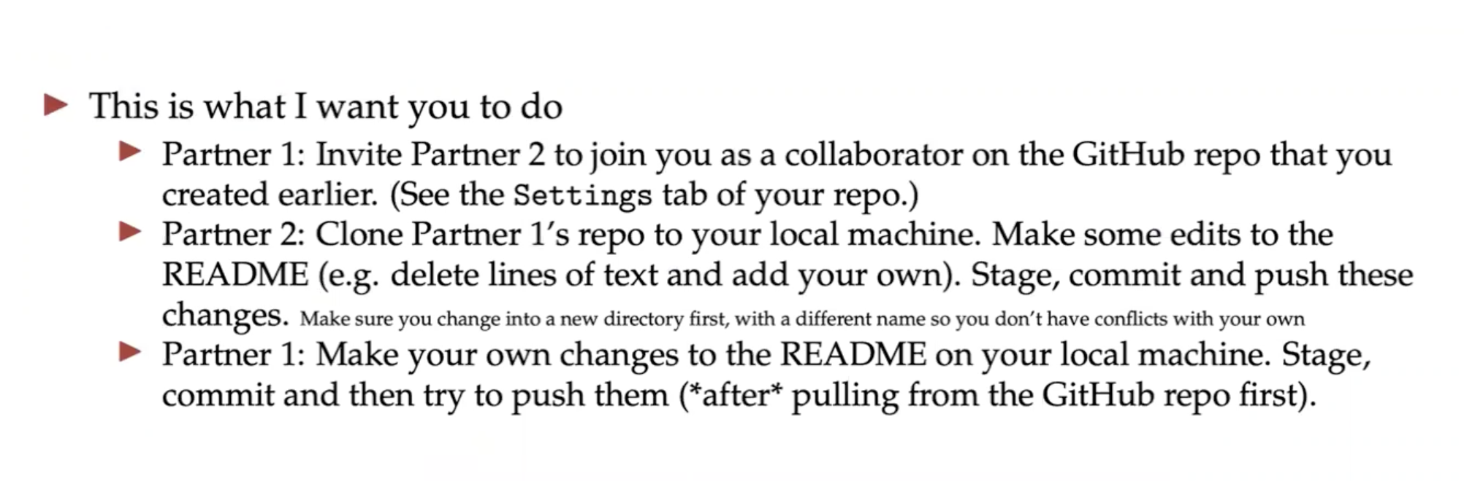
Collaboration time

Slide 6
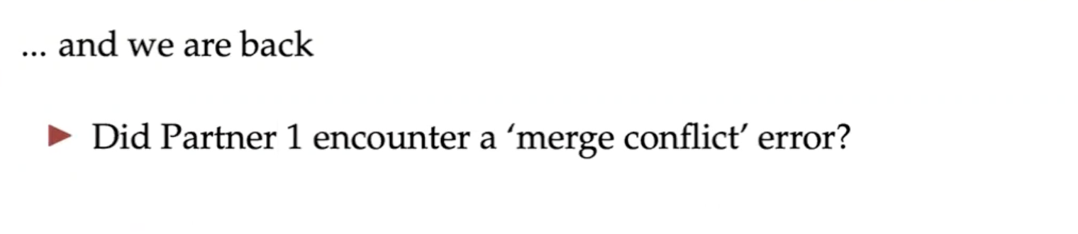
Collaboration time

Slide 7
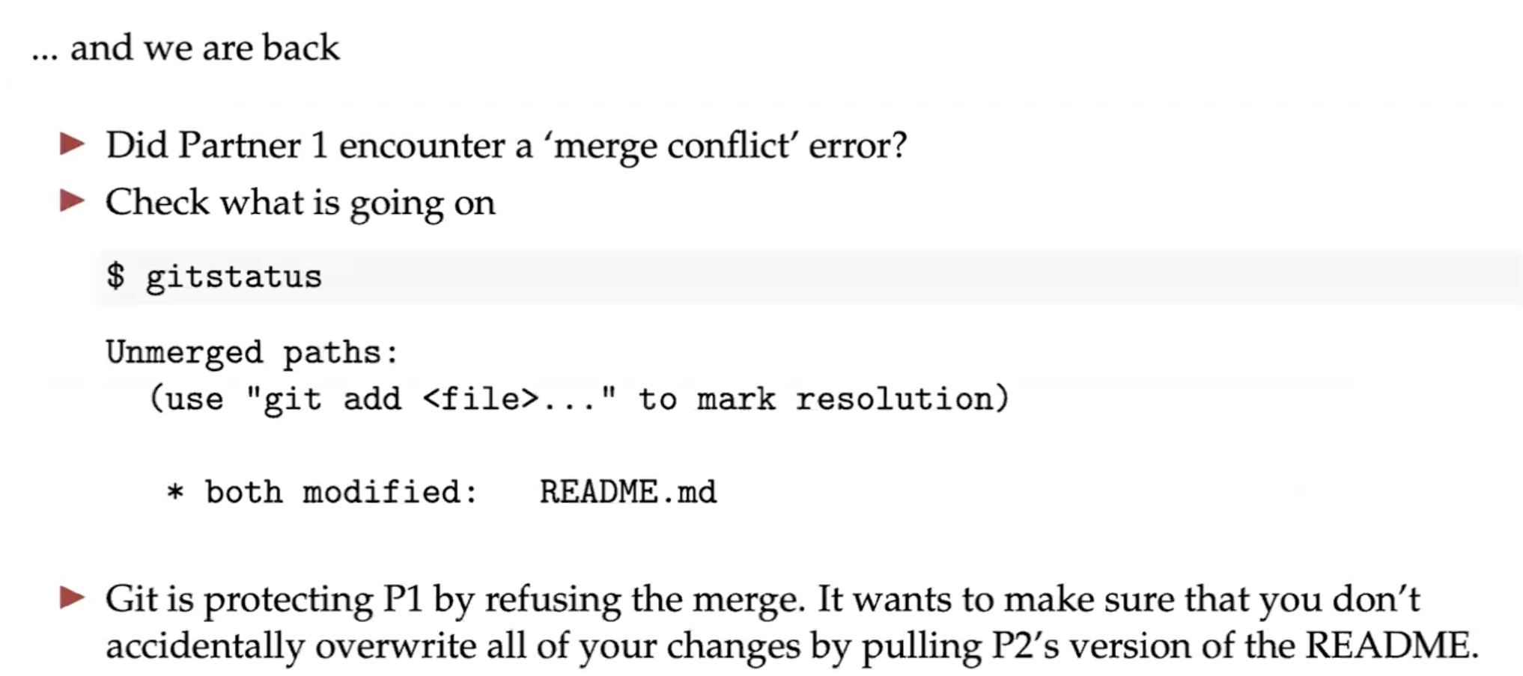
Collaboration time

Slide 8

Collaboration time

Slide 9
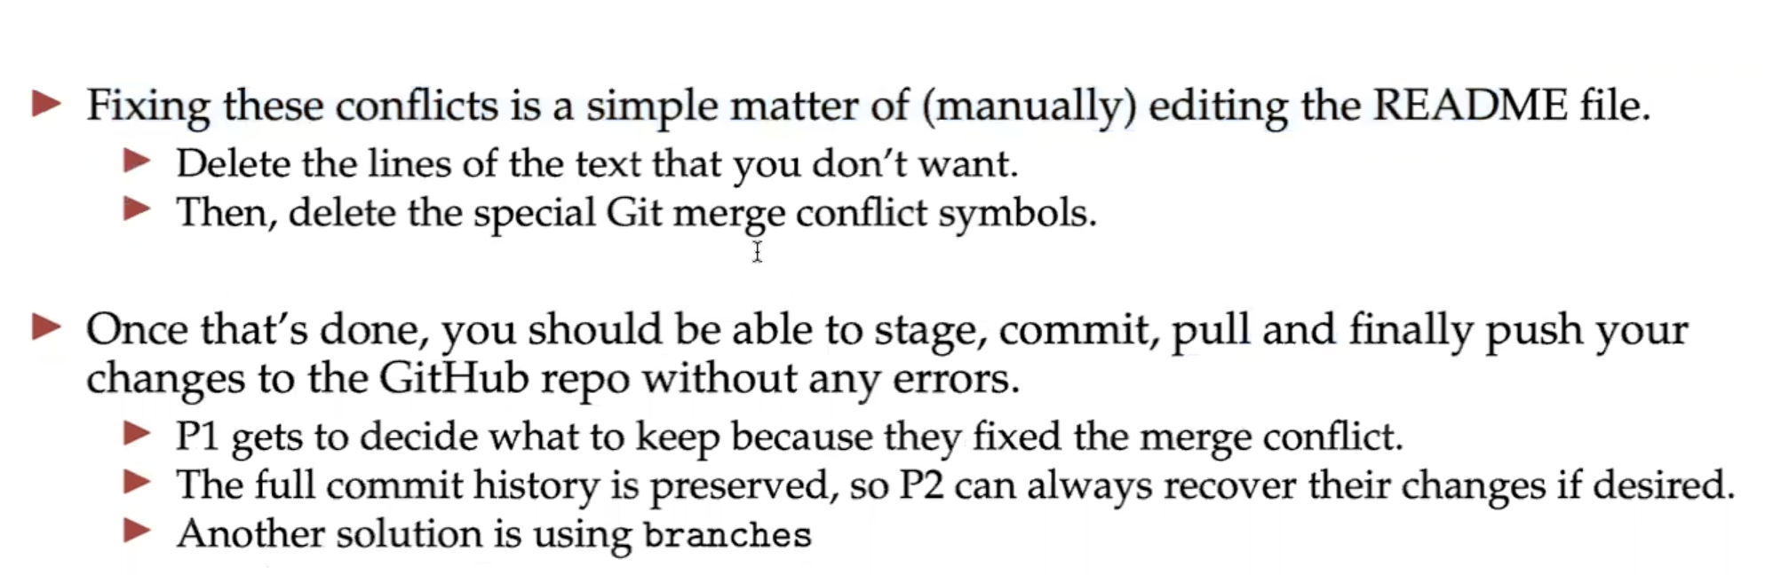
Collaboration time

Slide 10
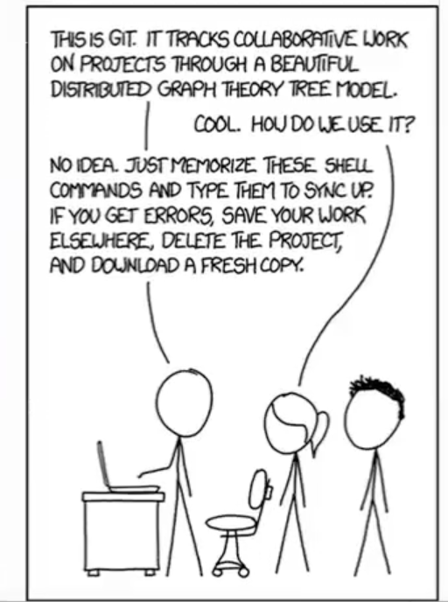

Collaboration time

